Slide 1


TELECOM Project
Setup environment and Build data warehouse
1st meeting
2022.06.26 by David yang

Slide 2
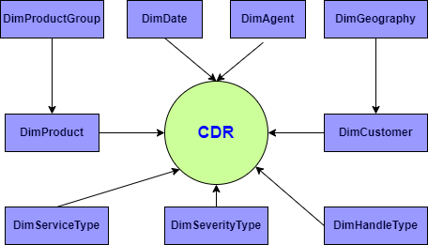
Concept Model

Slide 3
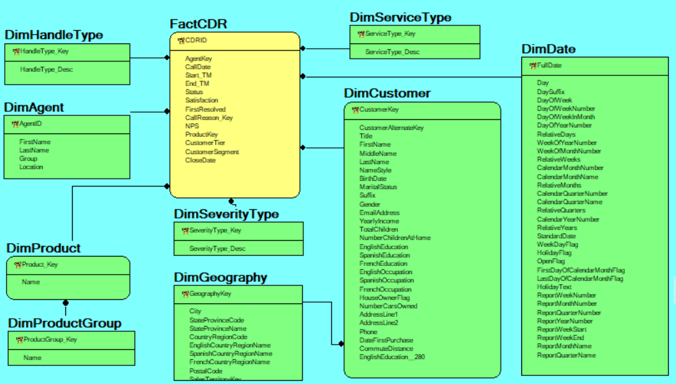
Logical Model

Slide 4
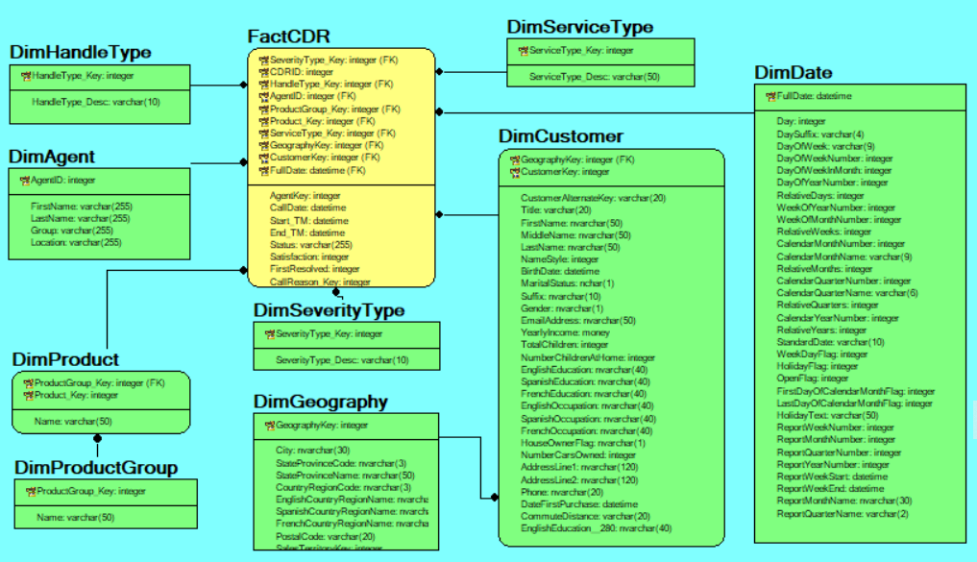
Physical Model

Slide 5
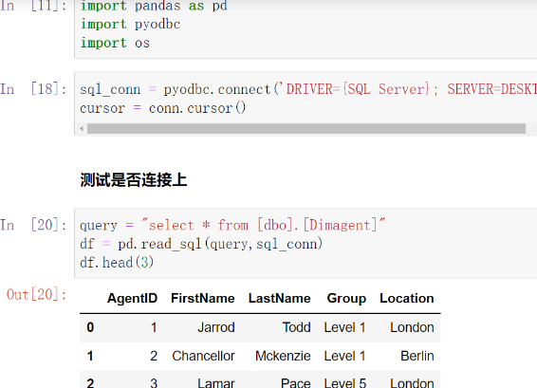
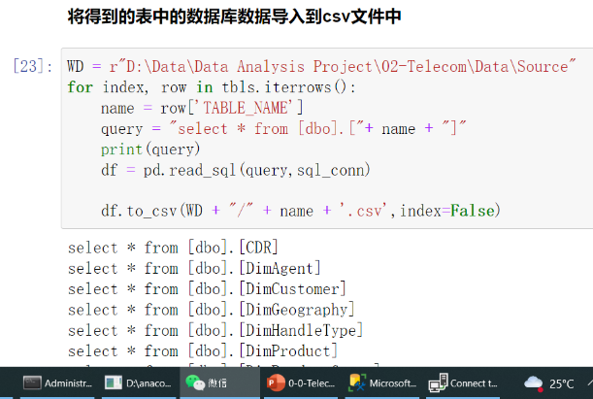
Connect between SQL Server and Python

Slide 6
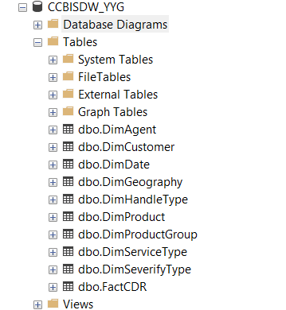
Creat the DW Database

Slide 7
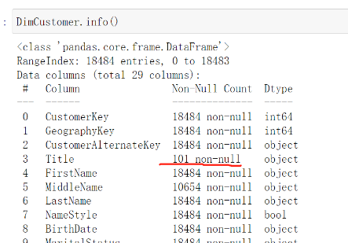
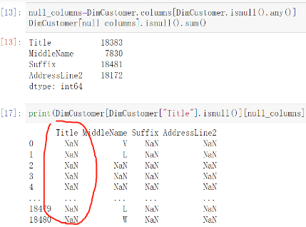
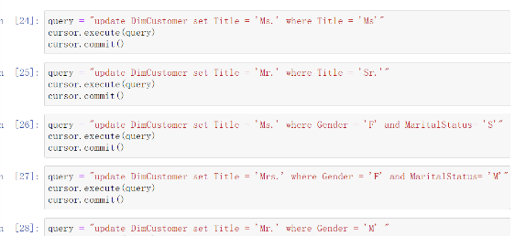
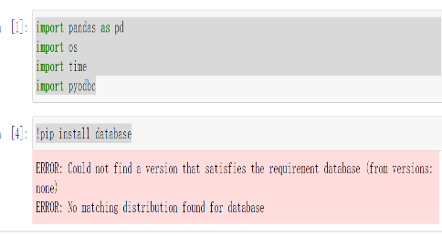
Cleaning the DimCustomer Table

Slide 8
TELECOM Project
ETL Tableau
2nd meeting
2022.07.10 by David yang

Slide 9

Agenda
Pre-processing data with Python
Data-Load into DW Database
Data Visualization

Slide 10
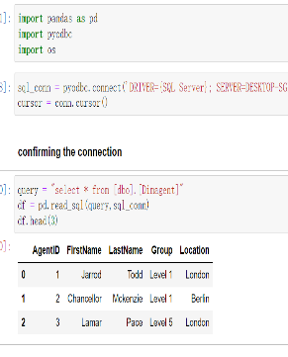
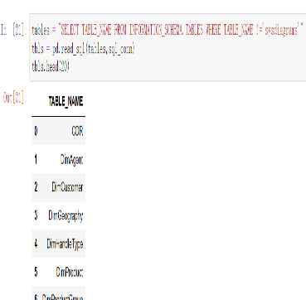
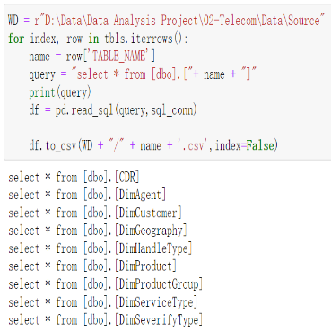
Import data from .csv into Python

Slide 11
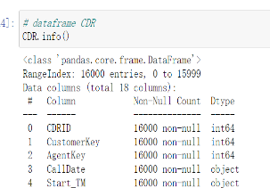
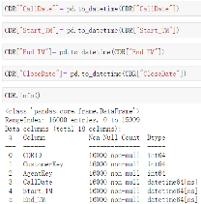
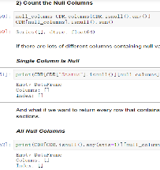
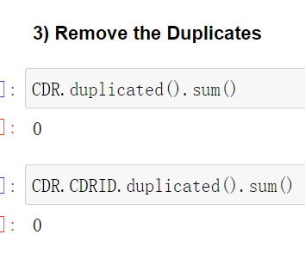
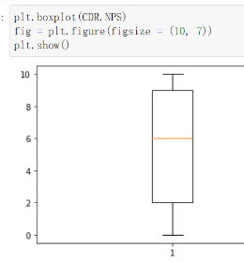
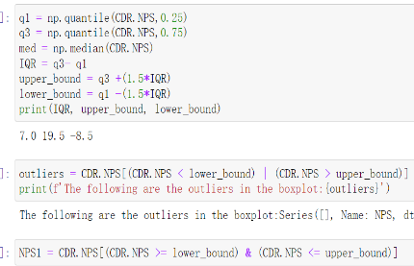
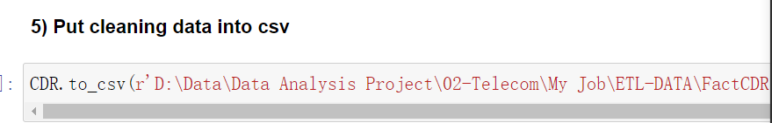
Data Cleasing ----FactCDR
Data overview
Fixe the datetime type
Check for null values
Check the duplicates
Boxplot
Detecting outliers ---IQR rules
Put cleaning data into csv

Slide 12
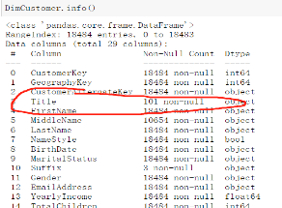
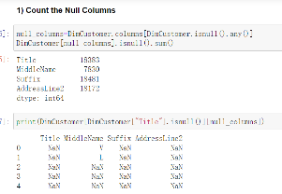
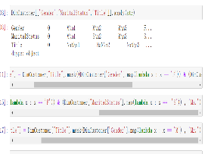
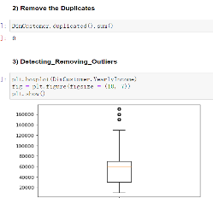
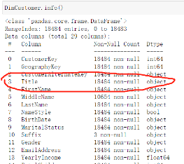
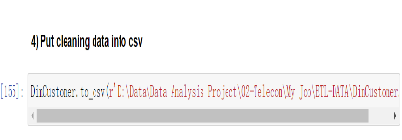
Data Cleasing ----DimCustomer
Data overview
Check for null values
Missing value handling
Duplicates and Outliers handling
Confirm the handling
Put cleaning data into csv

Slide 13
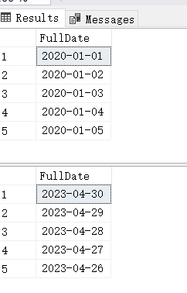
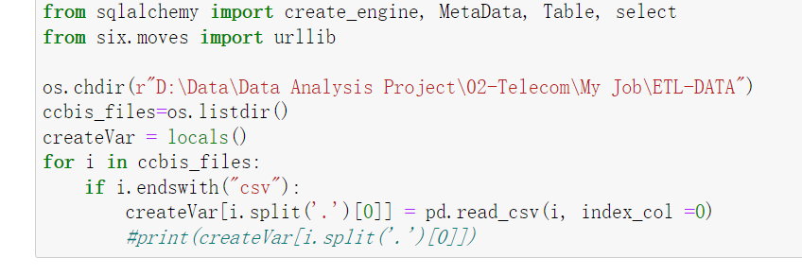
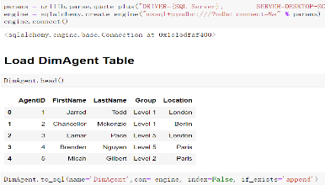
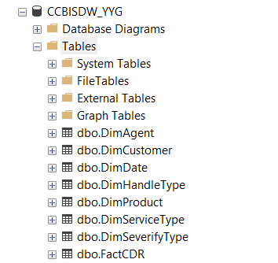
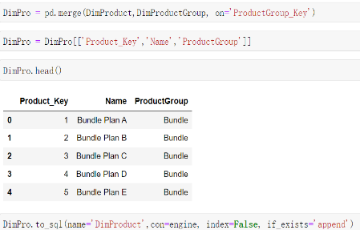
Data validation & Data-Load into DW Database
Datetime Fixed
Generate dataframe from CSV
Create a database connection engine
Combinate tables

Slide 14
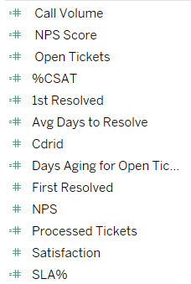
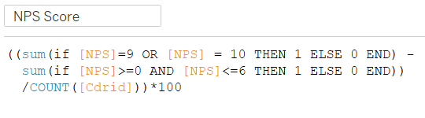
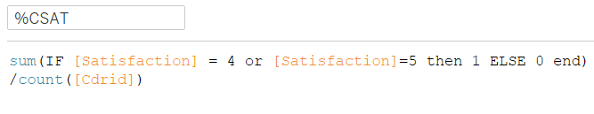
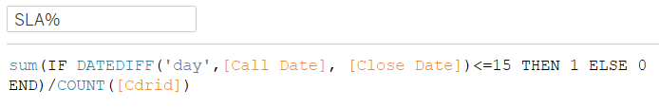
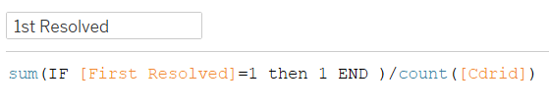
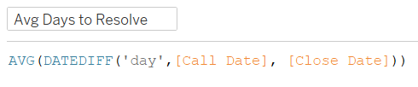
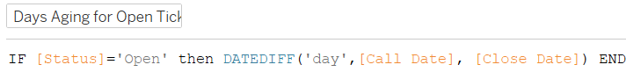
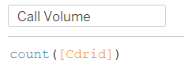
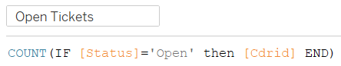
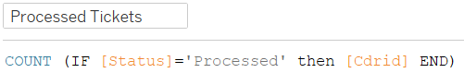
Prepare data sets for reporting and analysis
Net Promoter Score (NPS)
Satisfaction
First Resolved
Cdrid

Slide 15
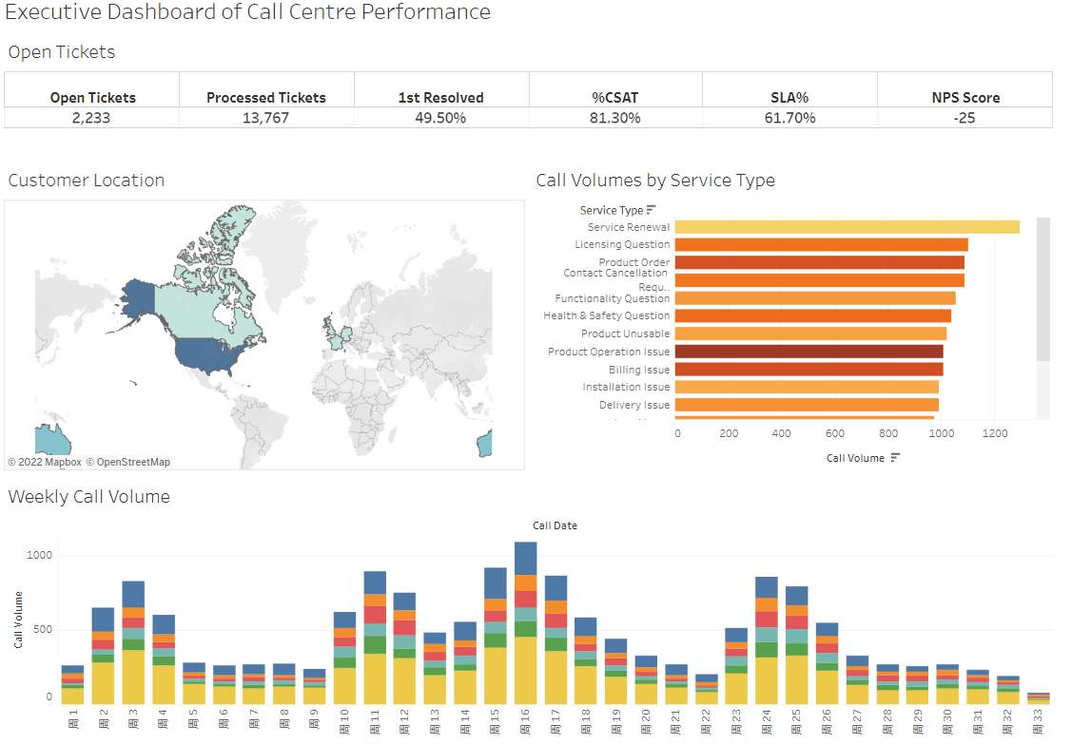
Data validation

Slide 16
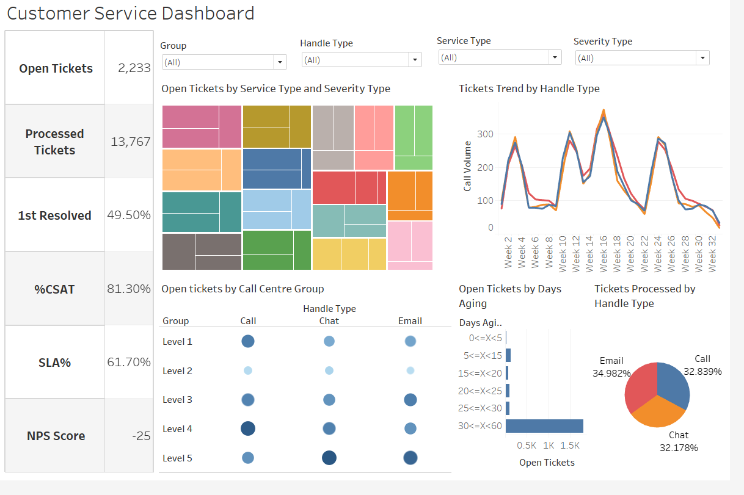

Slide 17
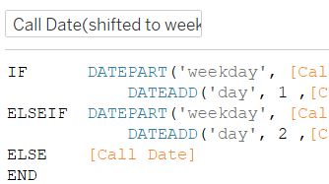
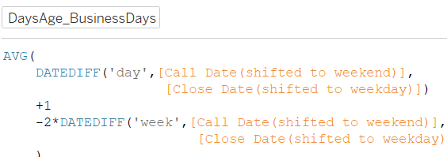
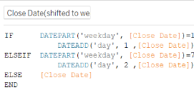
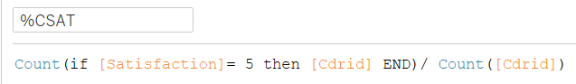
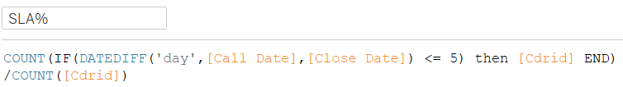
Prepare data sets for reporting and analysis

Slide 18
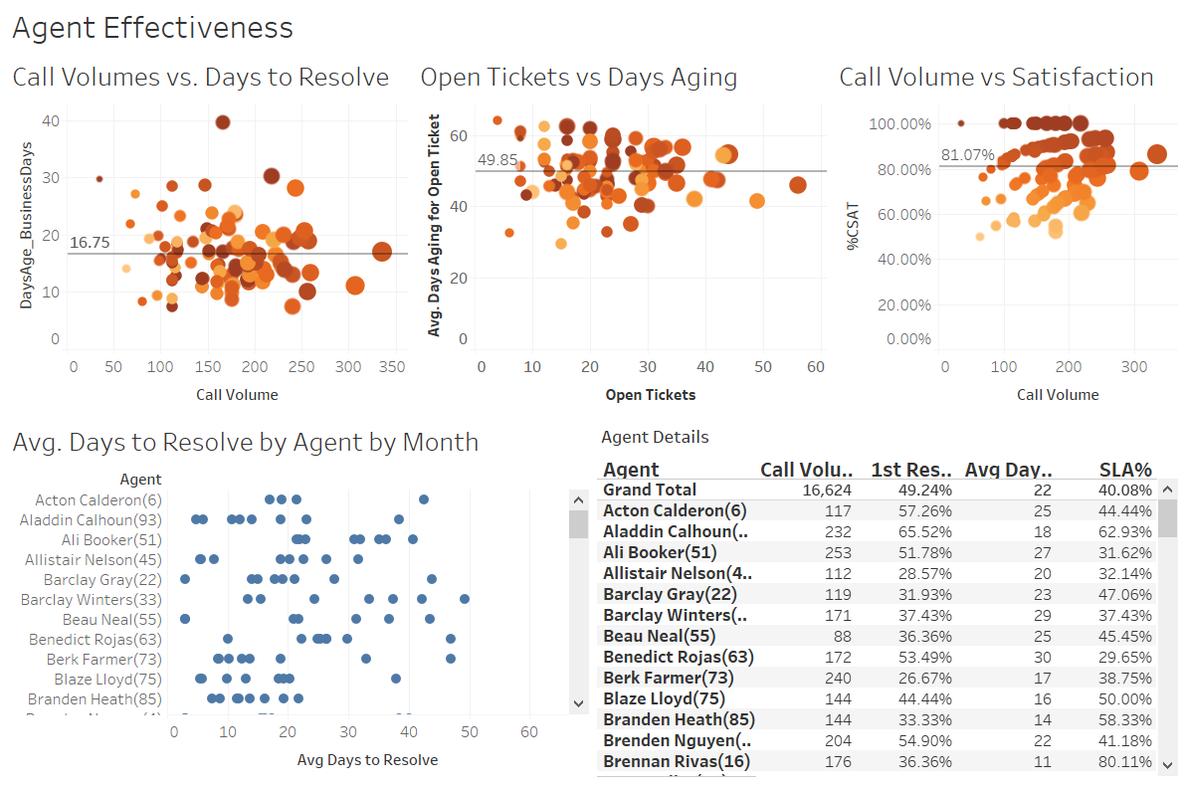

Slide 19
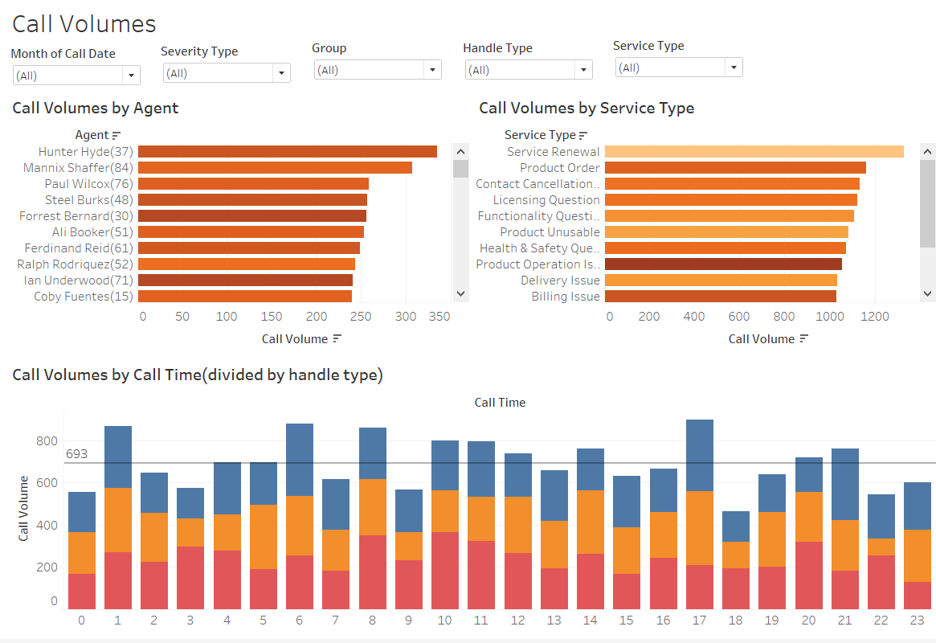

Slide 20
TELECOM Project
Data Visualization
3rd meeting
2022.07.17 by David yang

Slide 21
Agenda
Telecom Data Visualization
Telecom Churn Analysis
Retails RFM Analysis

Slide 22

Telecom Data Visualization---Relative Date

Slide 23

Telecom Data Visualization---Last N Report Weeks

Slide 24

Telecom Data Visualization---Executive Dashboard

Slide 25

Telecom Churn Analysis 1

Slide 26

Telecom Churn Analysis 2

Slide 27

Telecom Churn Analysis 2

Slide 28

Telecom Churn Analysis 3

Slide 29

Retails RFM Analysis

Slide 30

Thanks

